Slide 1
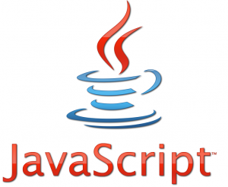
It’s not Java!

Slide 2
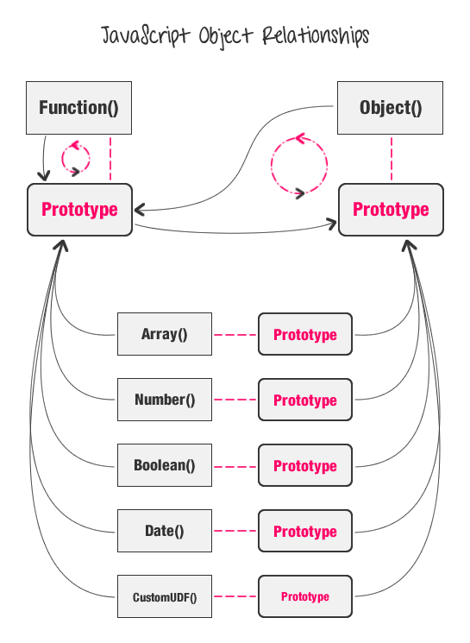
History and Development
10 day creation time
Brendan Eich - Beardless Creator
Functions as Objects
Lambda Calculus, Regular Expressions and Runtime Evaluation

Slide 3
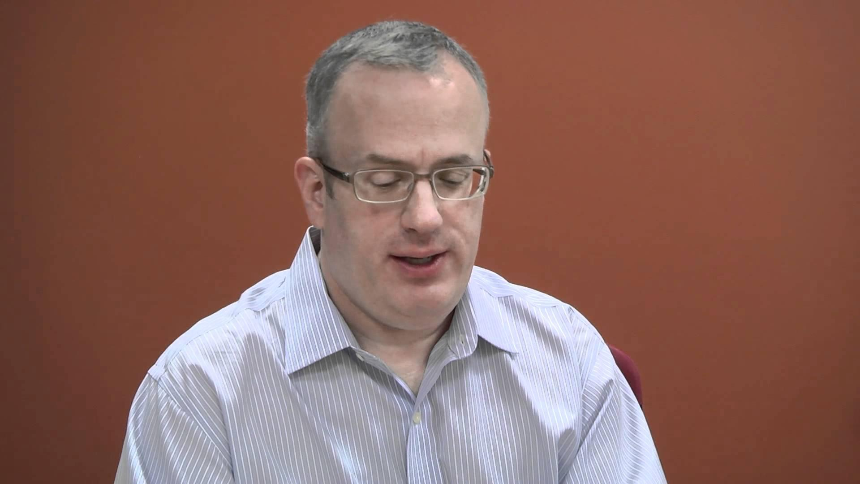
no beard

Slide 4
Microsoft does not play well with others
With Internet Explorer dropping out, JS2 stops
JQuery & AJAX added on afterwards
Standardization Specification for use across browsers

Slide 5
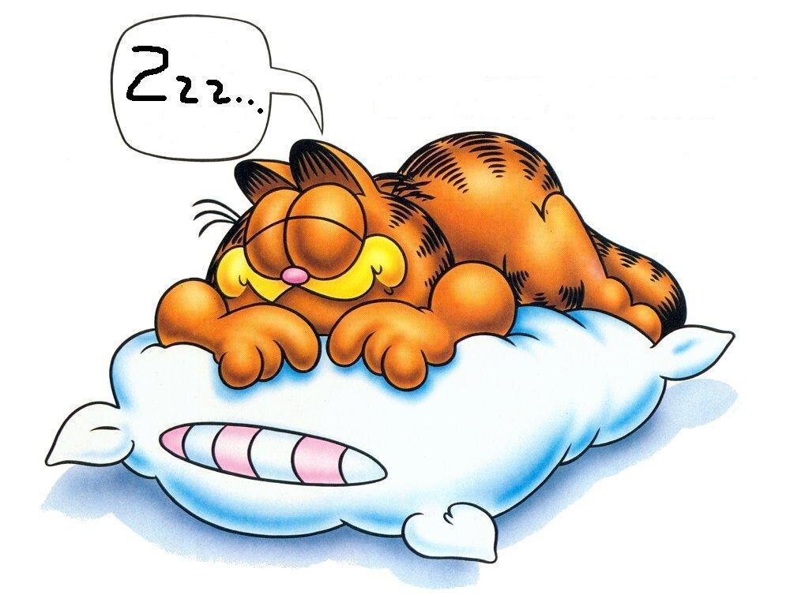
Lazy Evaluation
Functions passed as arguments are not evaluated until needed
Avoid extra computations
Allows use of infinite structures (if you’re careful)
Notes:
penis

Slide 6
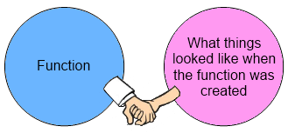
Closure

Slide 7
How to Closure?
Garbage Collection
Scope Chain References
Parameters in Function Calls

Slide 8
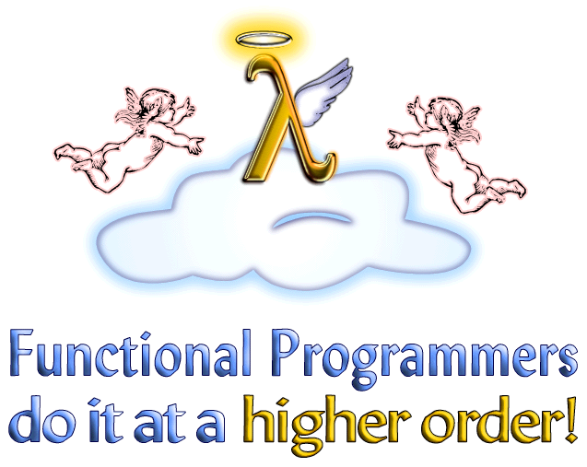
JavaScript and Higher Order
Most certainly, similar to Haskell
JS uses multiple parameters
Both use “currying”
Can achieve same functionality
in both languages

Slide 9
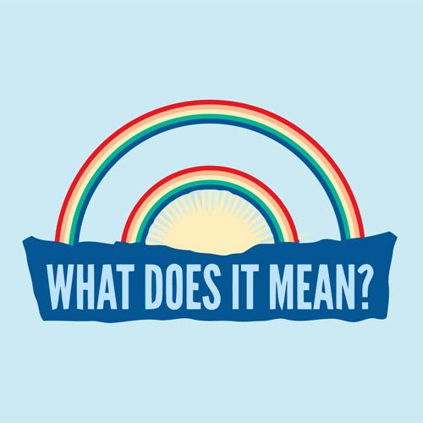
List Comprehension

Slide 10
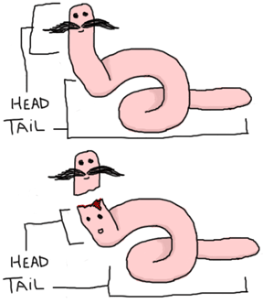
Syntactic Sugar (Haskell)
Loops vs. Array Comprehension
Square Brackets for implicit block
“let” implicit in javascript
Infinite Generators
Syntax is more restrictive in JS than Haskell
JS is more clear, readable and understandable

